Slide 1

Sustainable water management: planning, water utilities evaluation, development in Hungary and worldwide

Slide 2
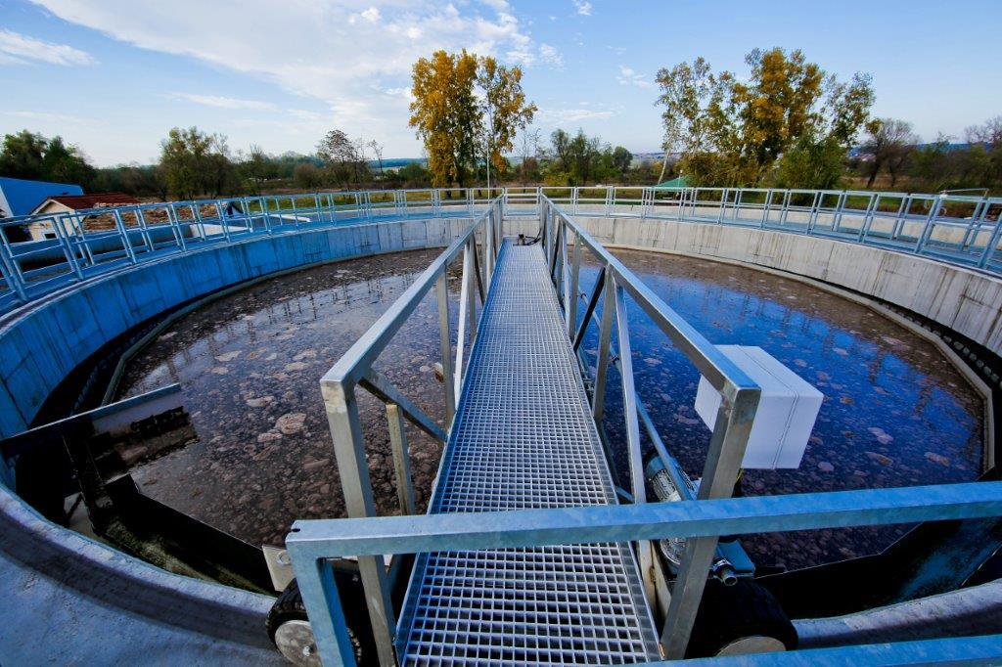
Company profile
Civil- and environmental engineering design (complete preparation and construction), design of water utilities
Drinking water treatment
Municipal and industrial wastewater treatment
Environmental remediation
Utility Evaluation based on Multifaceted Integrated Utilities Assessment Database software (MIAD/TIKA)
Asset Management, Rolling Development Planning
Economic Planning: Dynamic Cost Comparison Calculations (DCC), option analysis
Life cycle cost approach (LCC)

Slide 3
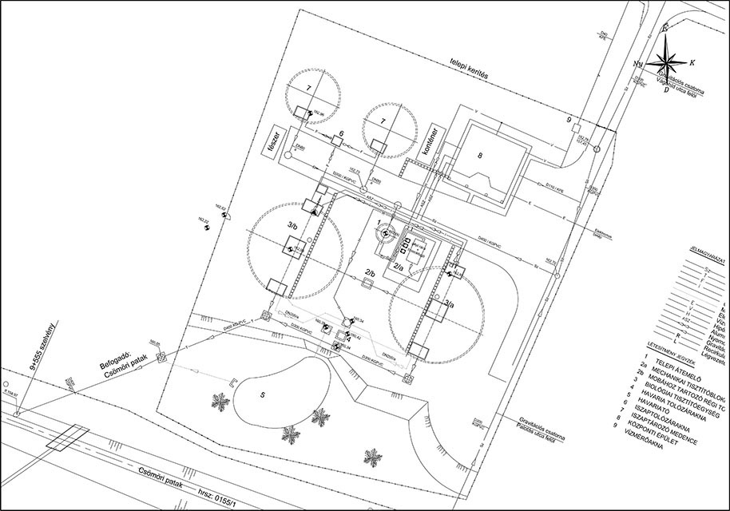
Company profile
Technical support and consulting
Feasibility studies and preliminary and Conceptual design
Detailed design and preparation of tender documents
Construction supervision
Project management
Consulting during startup and operation
R&D activities

Slide 4
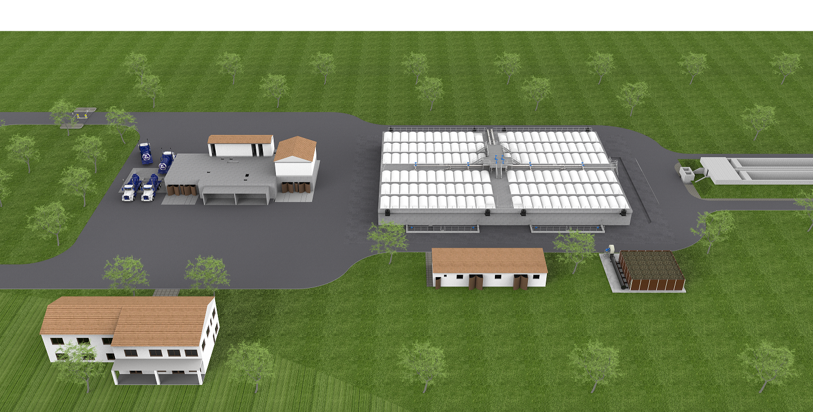
Top References / Wastewater Treatment Plant (WWTP) Design in Ghana
sniffed sewage purification
1.000 m³/d, 2.800 kg BOD5/n, 22.000 kg COD/n
Complex mechanical pre-treatment unit, primary cleaning, biology, sludge dewatering, disinfection

Slide 5
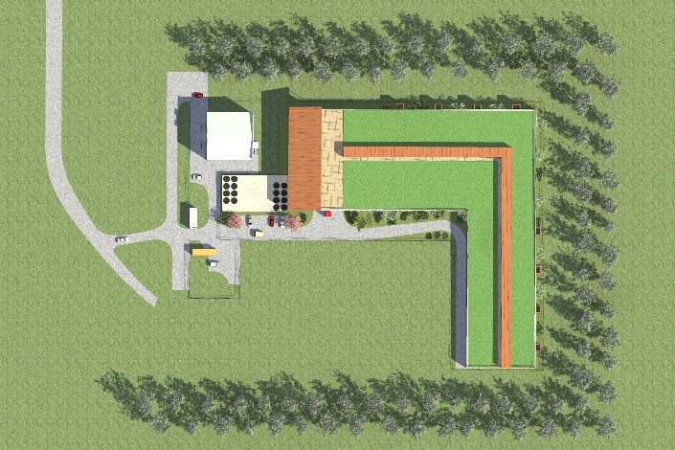
URBAN WATER TREATMENT PLANT IN YEKATERINBURG, RUSSIA
Urban water treatment in Yekaterinburg , Russia
15.000 m³/d
100.000 PE
WWTP near residential area, recycled treated water in a thermal power plant
Mechanical cleaning, biological cleaning (MBR system, pluscarbon source with dosing option), third purification stage (RO)

Slide 6
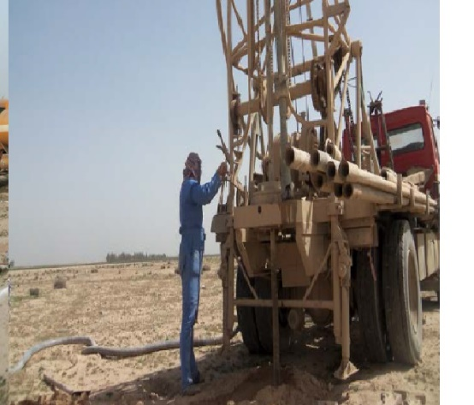
WWTP IN IRAQ
9 308 m³/d
46 542 PE
Technological and hydraulic calculations
general and technological description
trial operation plan
general construction design
Mechanical and biological treatment, sludge management

Slide 7
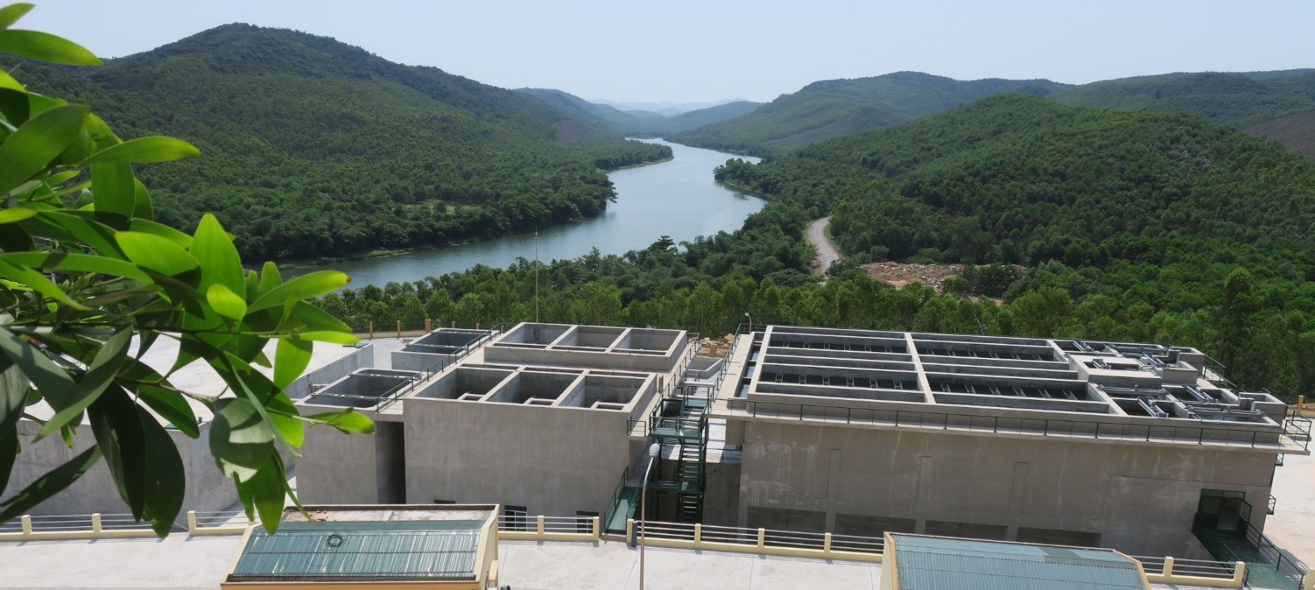
WATER TREATMENT PLANT IN VIETNAM
Quang Trach District Quang Bihn Province
surface water intake from river
Water + construction legal permission plan / complete detailed design
10.000 m³/d
Videó

Slide 8
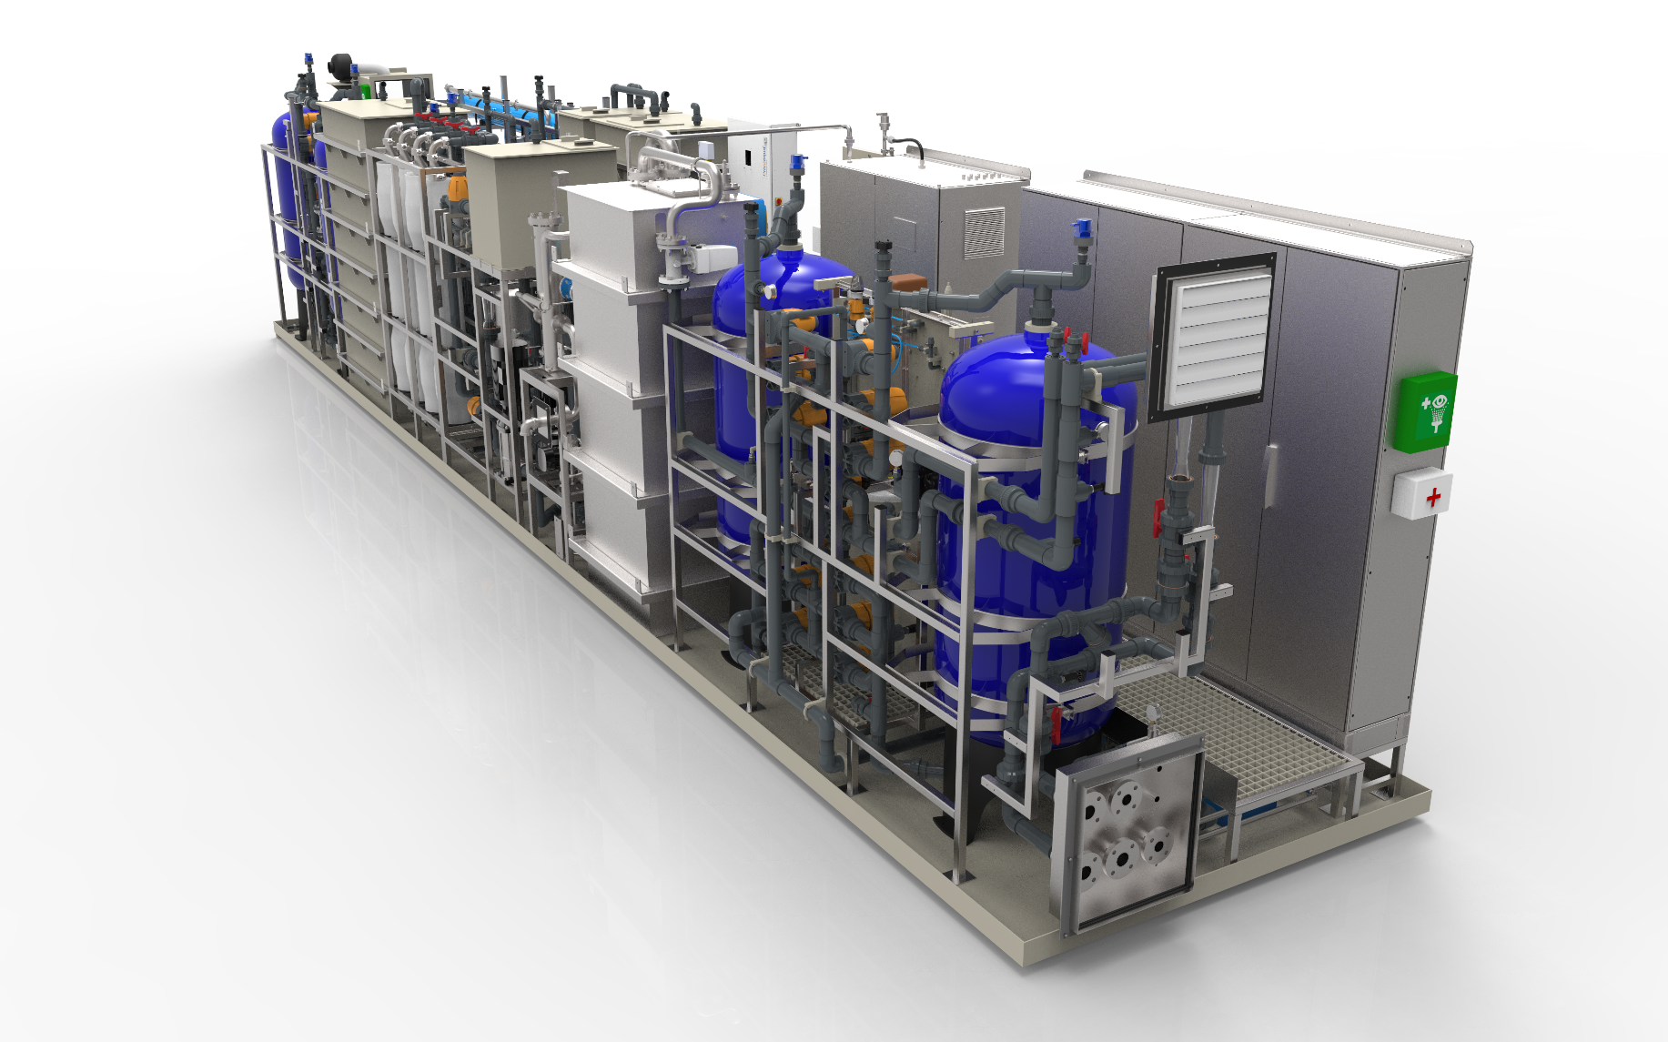
ReWater container
Drinking water from biologically treated wastewater
Membrane Technology (RO)
BWS 2016 Innovation Award
180 m3 / day = supply of drinking water to 72 thousand people

Slide 9
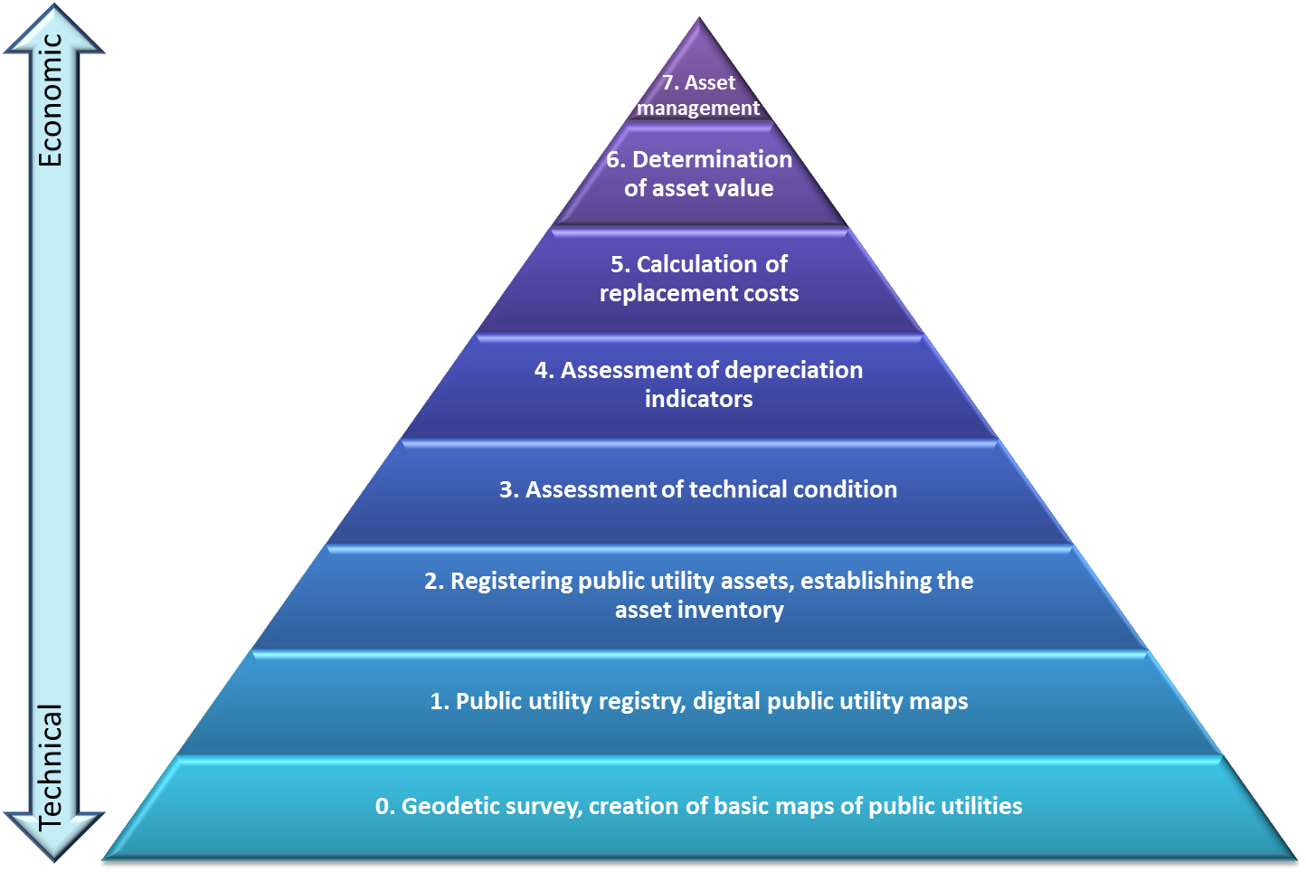

Utility Evaluation based on Multifaceted Integrated Utilities Assessment Database software (MIAD/TIKA)
Water utility evaulation is a bases for the predictable and sustainable operation/asset management and better decision-making
structured utility database = objective view of the quantity information, real economic and technical state and current ownership of the utility assets
Multifaceted Integrated Utilities Assessment Database– TIKA/MIAD szoftver
By TIKA software is evaluated water supply network and sewer network, and the water utility network, and technological facilities of more than 2000 settlements

Slide 10
Most important water utility evaluation references
Public utility asset evaluation of the municipality-owned water public utility, operated by the Regional Water Works
Regional Water Works : Transdanubian Regional Waterworks Ltd. - TDRW
Danube Regional Waterworks Ltd. - DRW
Tisza Regional Waterworks Ltd. - TRW
North Hungarian Regional Waterworks Ltd.- NHRW
North Transdanubian Waterworks Ltd.- NTDW
Affected settlements: 856 pcs
Affected inhabitants: 2 230 000 capita

Slide 11
IKVA - Integrated Water Utility Database - Hungary
National utility database and GIS
The goal of the IKVA project was the establishment of an Integrated Public Water Utility Database. Integration of data was needed to optimize public service dimensioning and supply models.
BDL Ltd. took a significant part of the development process
Creation, clarification and finalization of requirement specification, systematization of asset evaluations, rolling development plans, licensing and oversight data, etc
Preparation of materials and proposals for the legislative changes
IKVA regulation: 74/2018. (IV. 20.) on the designation and detailed rules of the operation of the Integrated Public Water Utility Database

Slide 12

ASSET MANAGEMENT FOR WATERWORKS
Need for replacement
Rolling development planning
Reconstruction forecast
Economic Planning (DCC, LCC)

Slide 13
Preparation of a replacement plan
Preparation of long-term replacement plan for Regional waterworks
Affected water utilities:
Affected settlements: 328 pcs
Affected inhabitants: 860 000 capita
Víziközmű objektumcsoport megnevezése | Total
 | km | pcs
Deep wells, conventional and large diameter | - | 667
Water works | - | 120
Water towers | - | 44
Water tank |  | 367
Drinking water pumping stations | - | 287
Drinking water network | 2 734,0 | -
Sewage pumping stations | - | 380
Wastewater treatment plant | - | 24
Sewage network | 421,2 | -

Slide 14
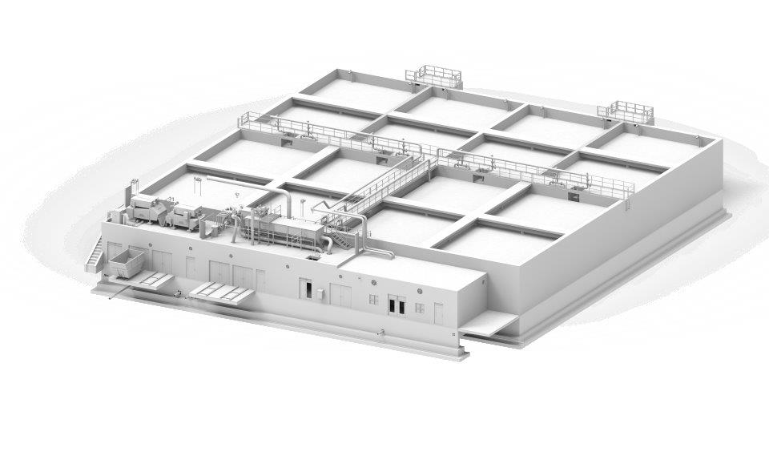
Highlights / Innovation
3D modeling
Design of new technological solutions
Continuous improvement
Monitoring market needs

Slide 15
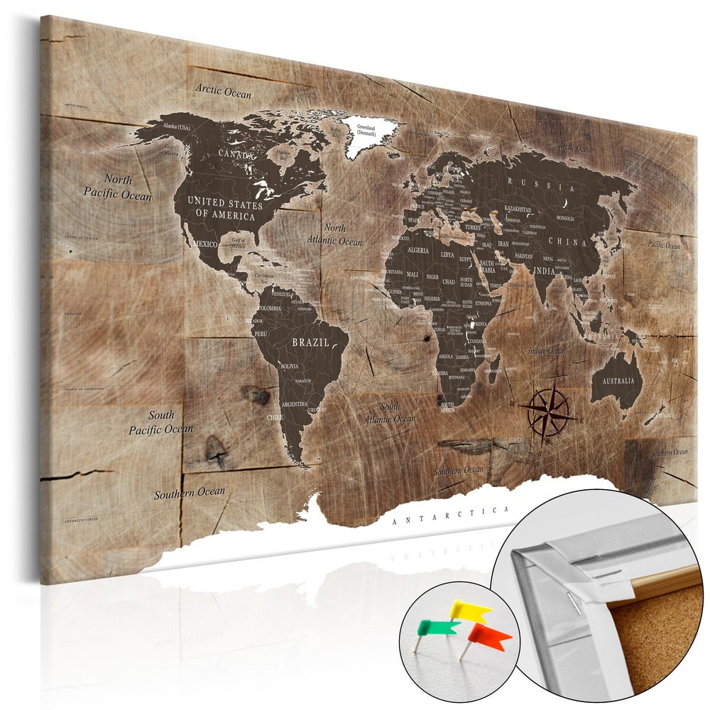
Strategic markets
Vietnam
China
Ghana
Egypt
Turkey
Serbia
Croatia
Macedonia
Albania

Slide 16
Thank you for your attention!
www.bdl.hu
info@bdl.hu
+36 1 224 0670

